Slide 1
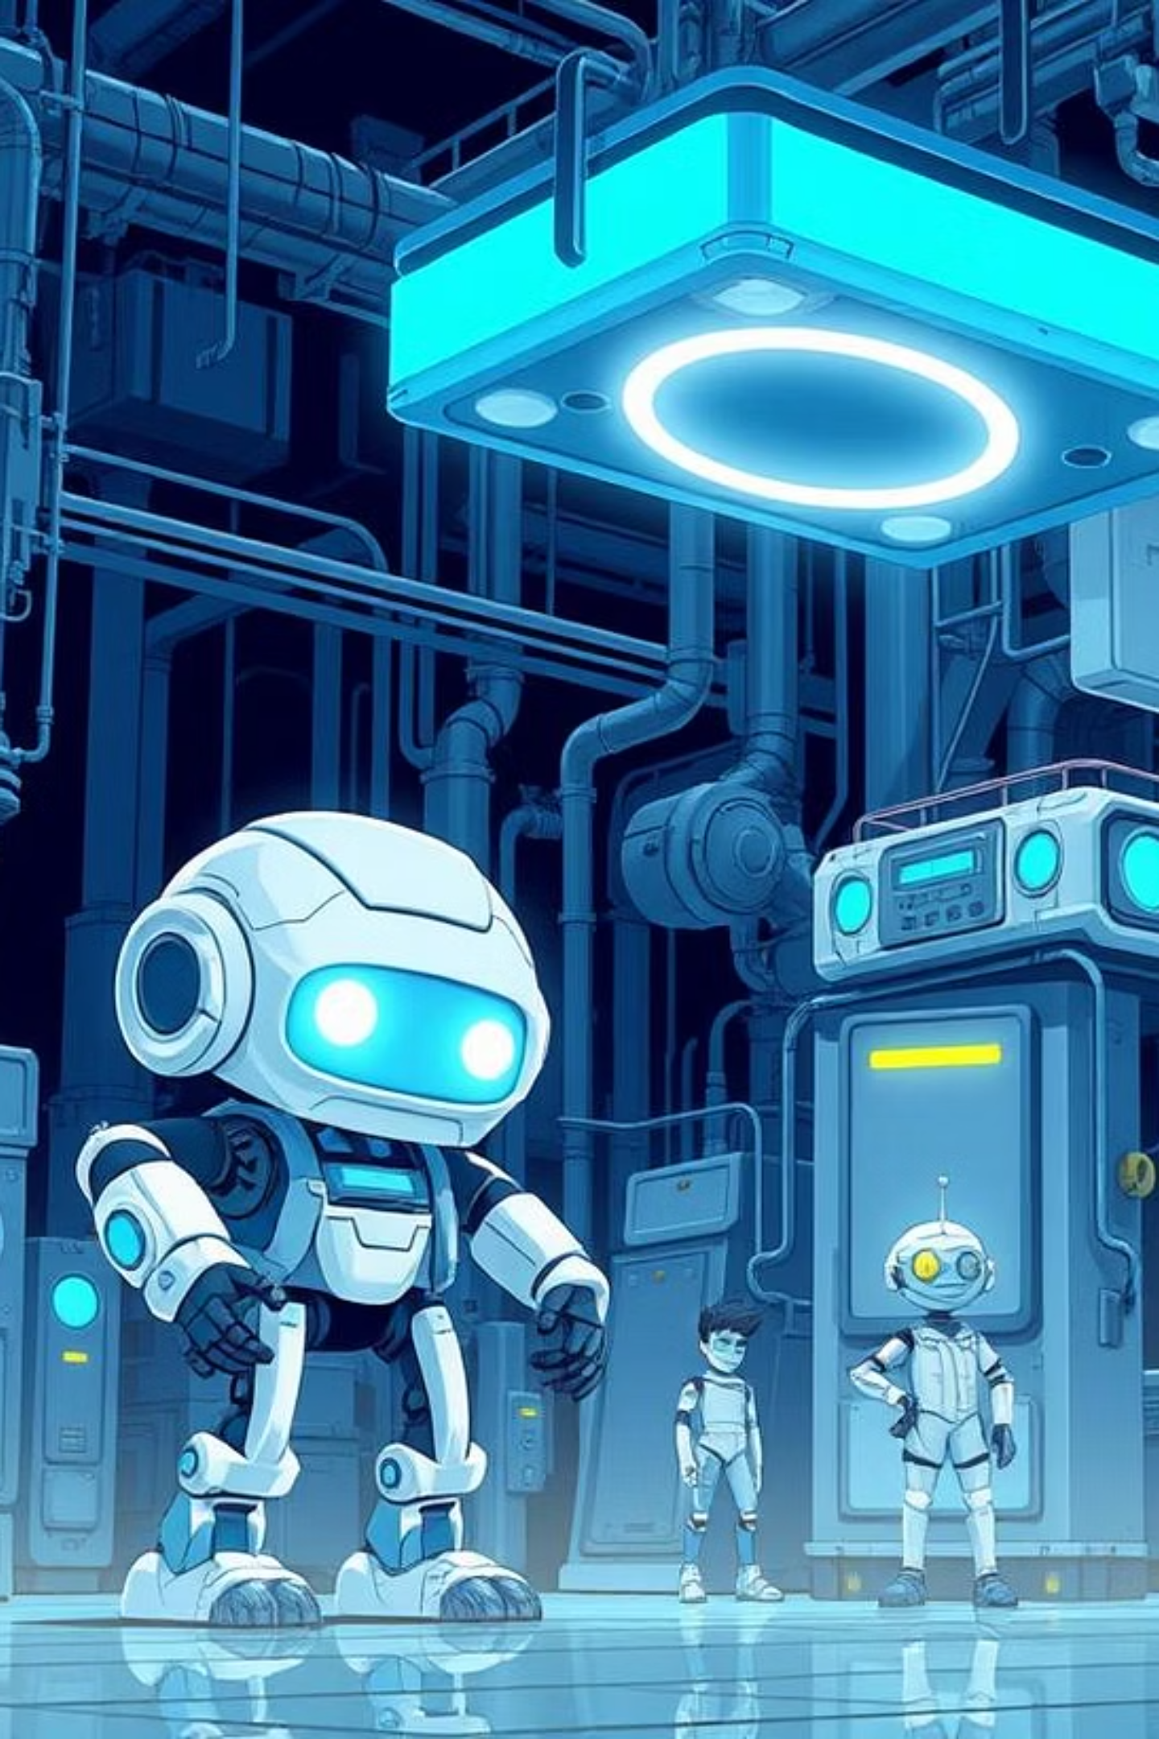

Industry 5.0 and the Future of Industrial IoT
Exploring the convergence of human ingenuity and advanced technology in the next era of industrial automation.

Slide 2
Agenda: Navigating the Industrial Revolution
Understanding Industry 5.0 and its evolution from previous industrial eras.
Deep dive into the key pillars of Industrial IoT (IIoT).
Exploring the pivotal roles of Edge Computing and AI.
Visualizing real-time data flow in smart factories.
Showcasing practical applications and case studies.
Addressing challenges, sustainability, and future trends.

Slide 3
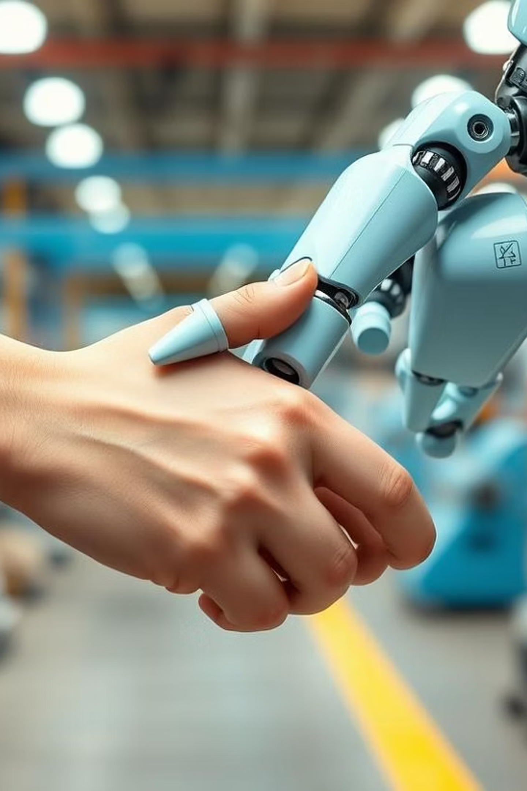
What is Industry 5.0?
Industry 5.0 shifts the focus from automation efficiency to human-centric solutions. It emphasizes collaborative robots (cobots), personalized production, and sustainable practices, ensuring technology serves human well-being and societal resilience.

Slide 4


From Industry 4.0 to 5.0: A Paradigm Shift
Industry 4.0: Automation & Connectivity
Industry 5.0: Human-Centric & Sustainable
Focused on mass production, data exchange, and cyber-physical systems, driven by efficiency and cost reduction.
Emphasizes human-robot collaboration, resilience, and environmental sustainability, fostering a more personalized and ethical industrial landscape.

Slide 5



Key Pillars of Industrial IoT (IIoT)
Sensors & Actuators
Connectivity & Networks
Data Analytics & Insights
Collecting real-time data from physical processes, environmental conditions, and machinery status. Essential for monitoring and control.
Ensuring seamless data transmission via protocols like MQTT, OPC UA, and 5G. Reliable networks are the backbone of IIoT.
Transforming raw data into actionable intelligence using machine learning and AI algorithms for predictive maintenance and operational optimization.

Slide 6

The Cloud: The Brain of IIoT
Cloud platforms provide scalable infrastructure for data storage, processing, and advanced analytics. They enable centralized management of distributed IIoT devices and facilitate global accessibility of industrial data for various applications.
Scalability: Dynamically adjust resources based on demand.
Accessibility: Access data and applications from anywhere.
Advanced Services: Leverage AI/ML, big data, and IoT services for deeper insights.
Cost-Efficiency: Reduce on-premise hardware and maintenance costs.

Slide 7
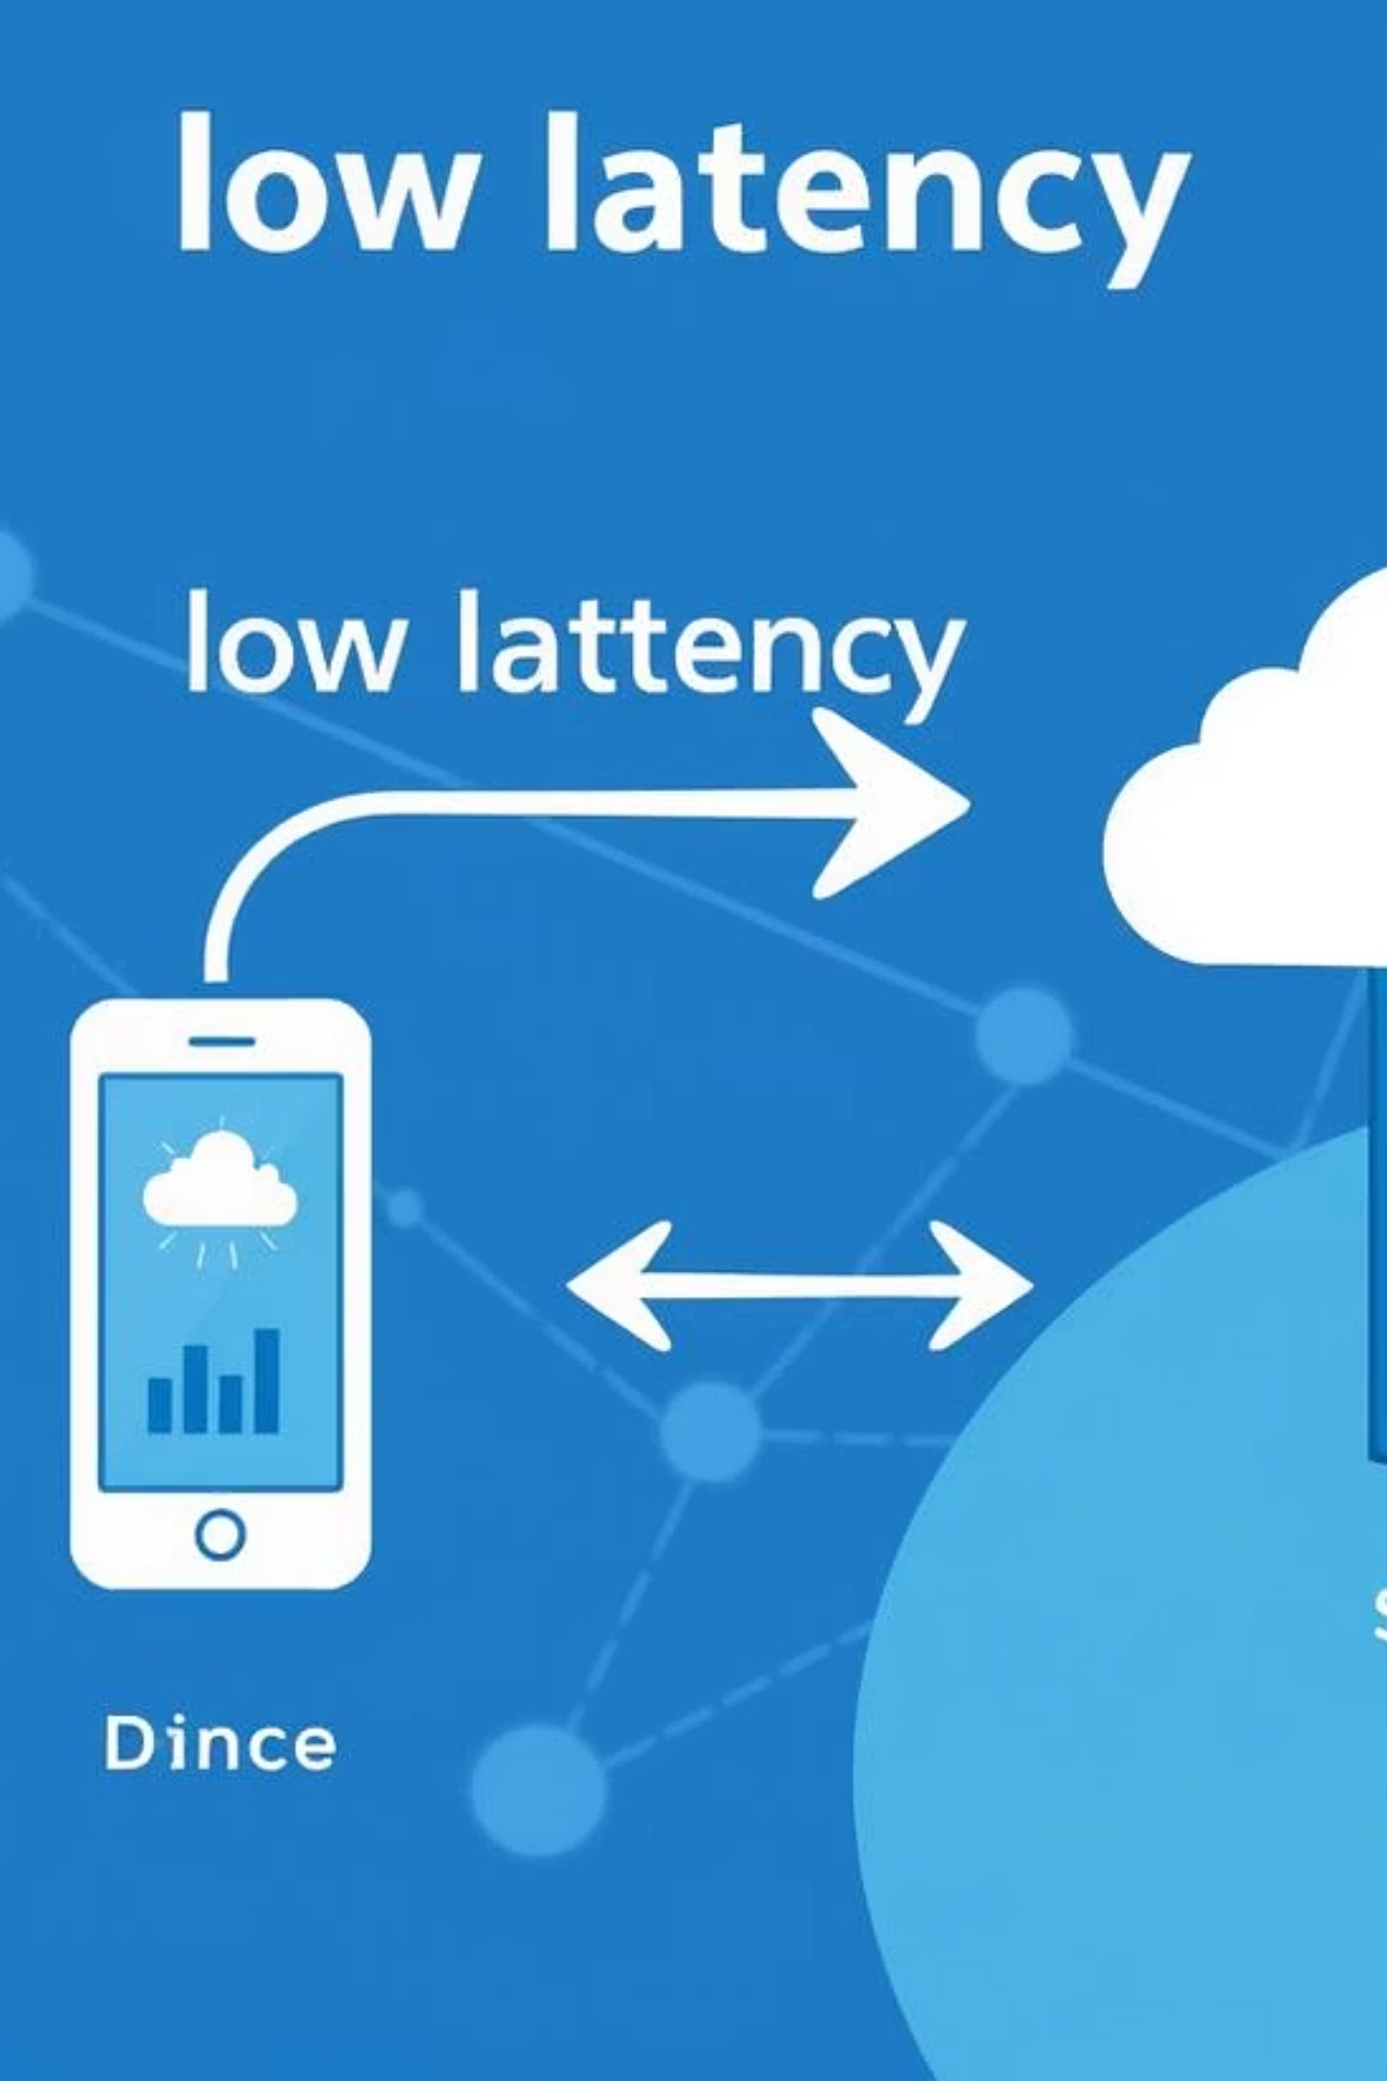
Edge Computing and AI: Decentralized Intelligence
Edge computing processes data closer to the source, reducing latency and bandwidth usage. Combined with AI, it enables real-time decision-making, predictive analytics, and autonomous operations directly on devices or local servers, enhancing efficiency and security.

Slide 8
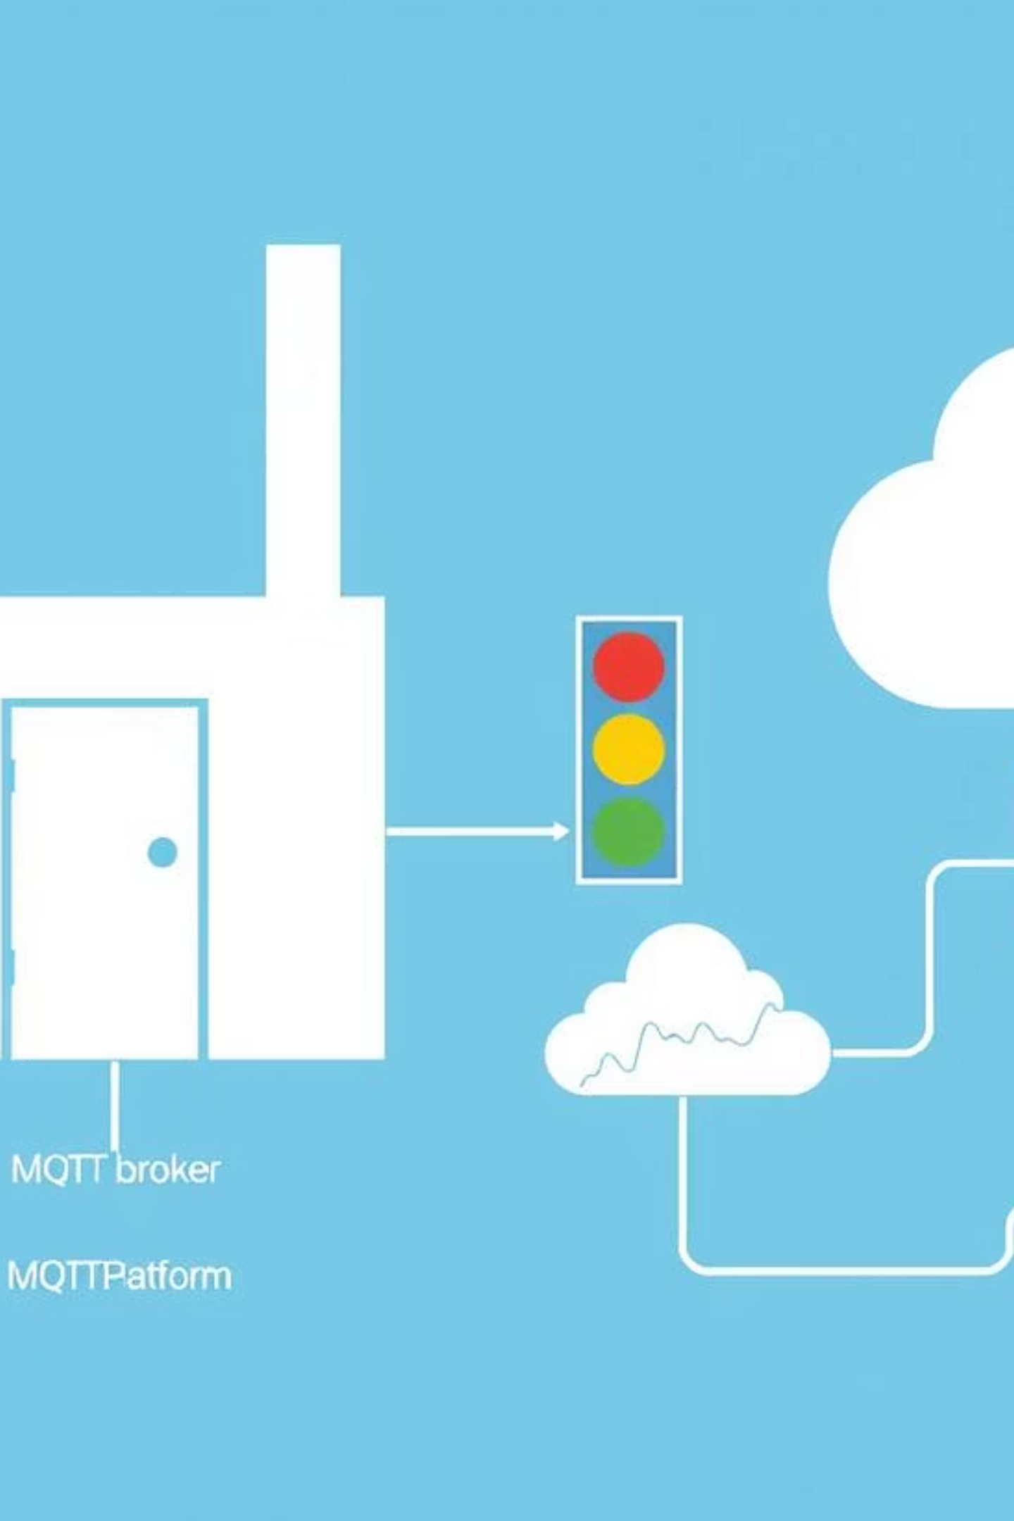
Real-Time Data Flow in a Smart Factory
In a smart factory, sensors collect data on production lines, machinery health, and environmental conditions. This data streams through secure networks to edge devices for immediate processing, and then to the cloud for comprehensive analytics and long-term storage.

Slide 9
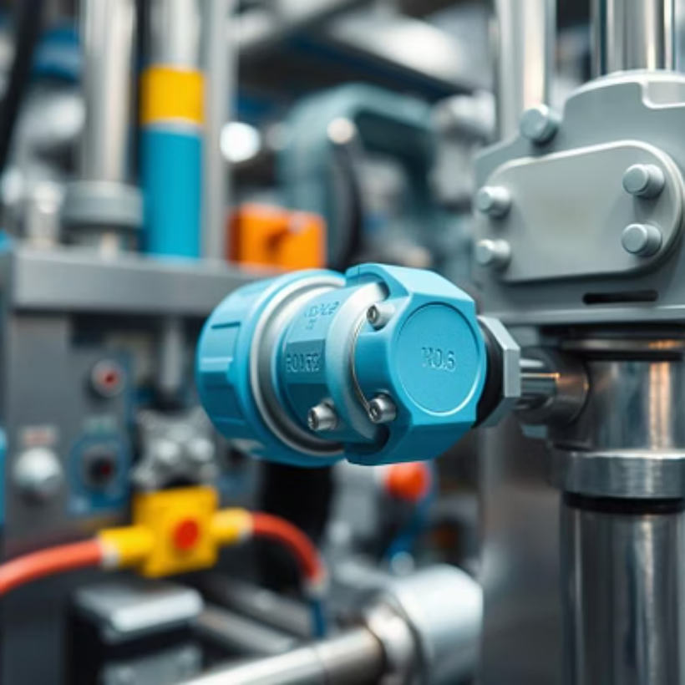

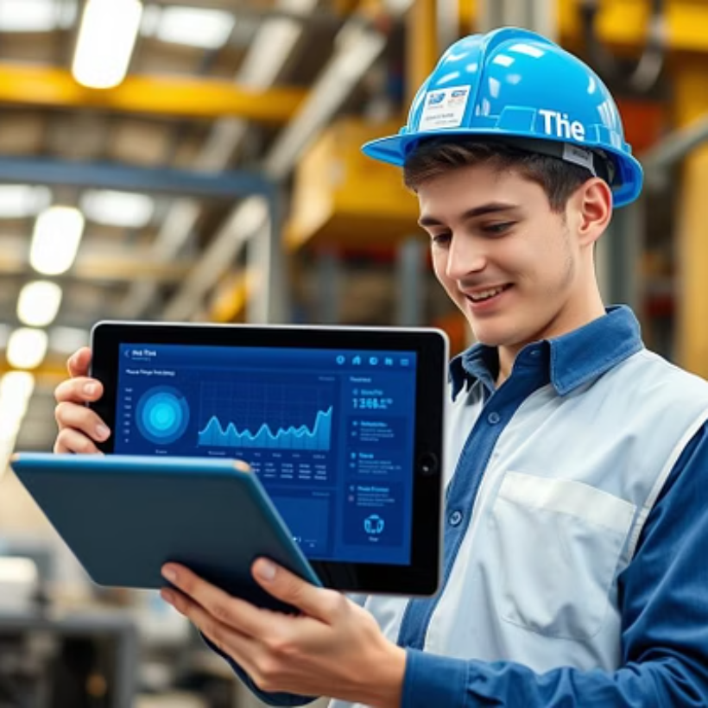
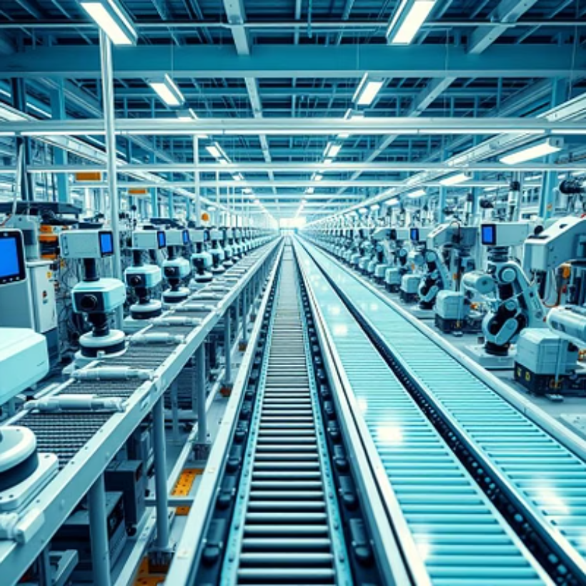
Visualizing the Smart Factory Data Journey
From the shop floor to the executive dashboard, every data point contributes to operational excellence. Real-time monitoring allows for immediate anomaly detection, predictive maintenance scheduling, and dynamic resource allocation, minimizing downtime and optimizing throughput.

Slide 10

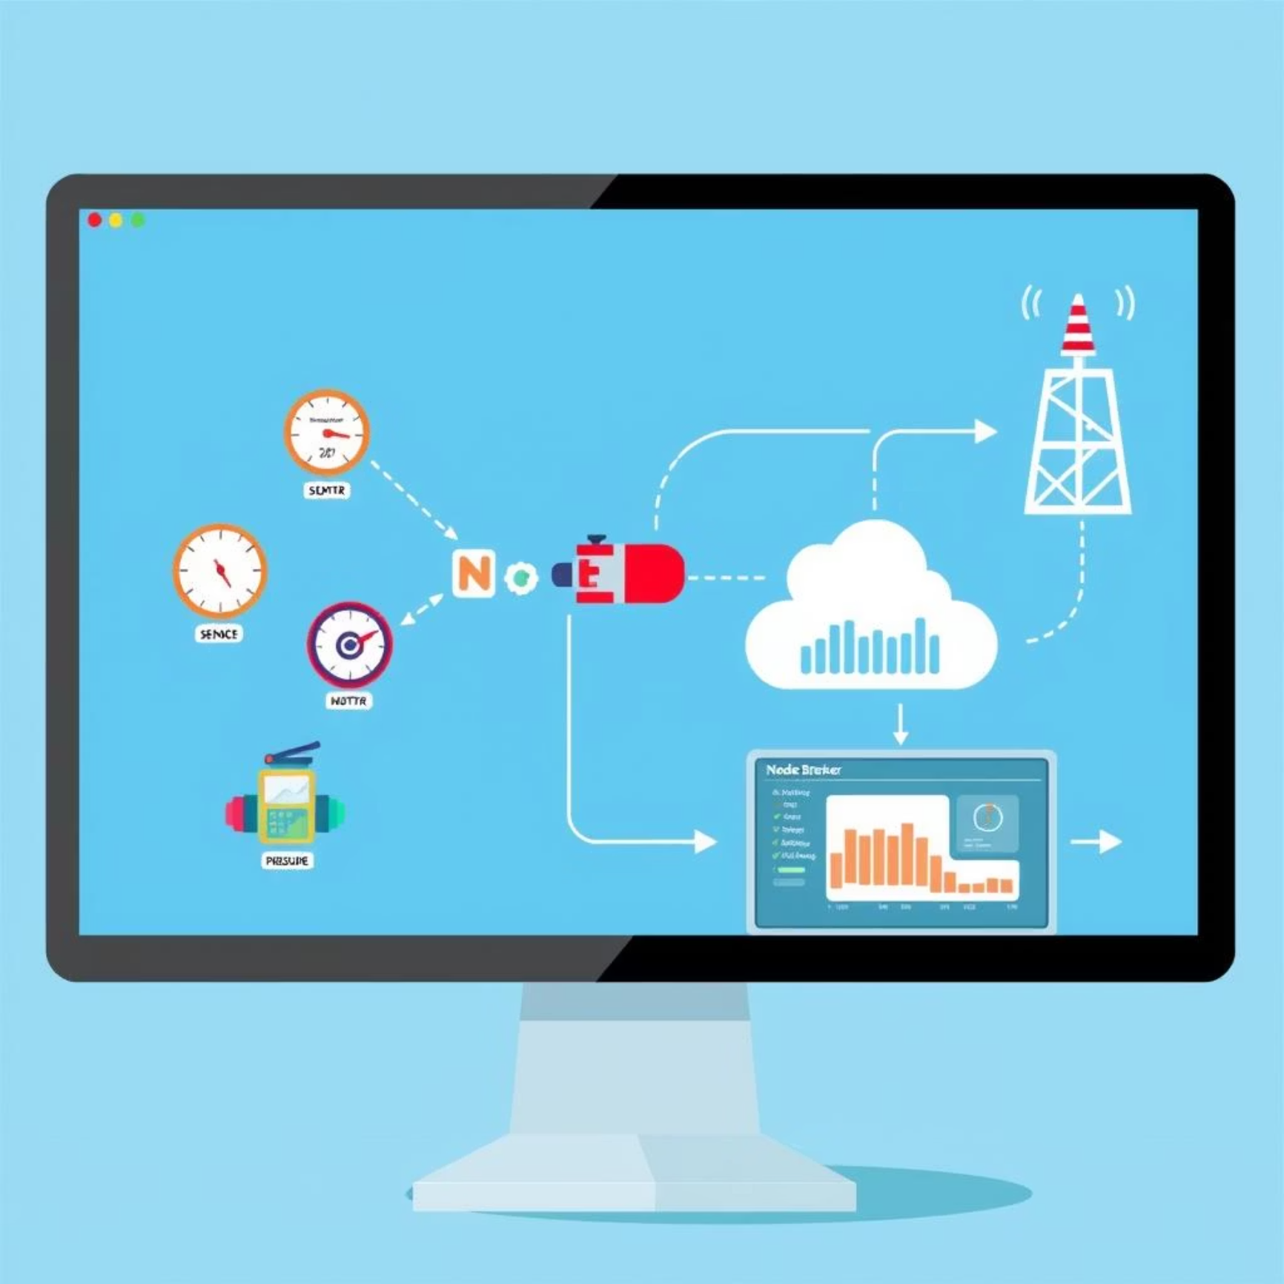
Live Demo
Observe a live demonstration showcasing the seamless flow of sensor data. We'll use dashboard for visual programming, MQTT for lightweight messaging, and a simulated sensor to illustrate real-time data acquisition and visualization, demonstrating a practical IIoT pipeline.

Slide 11
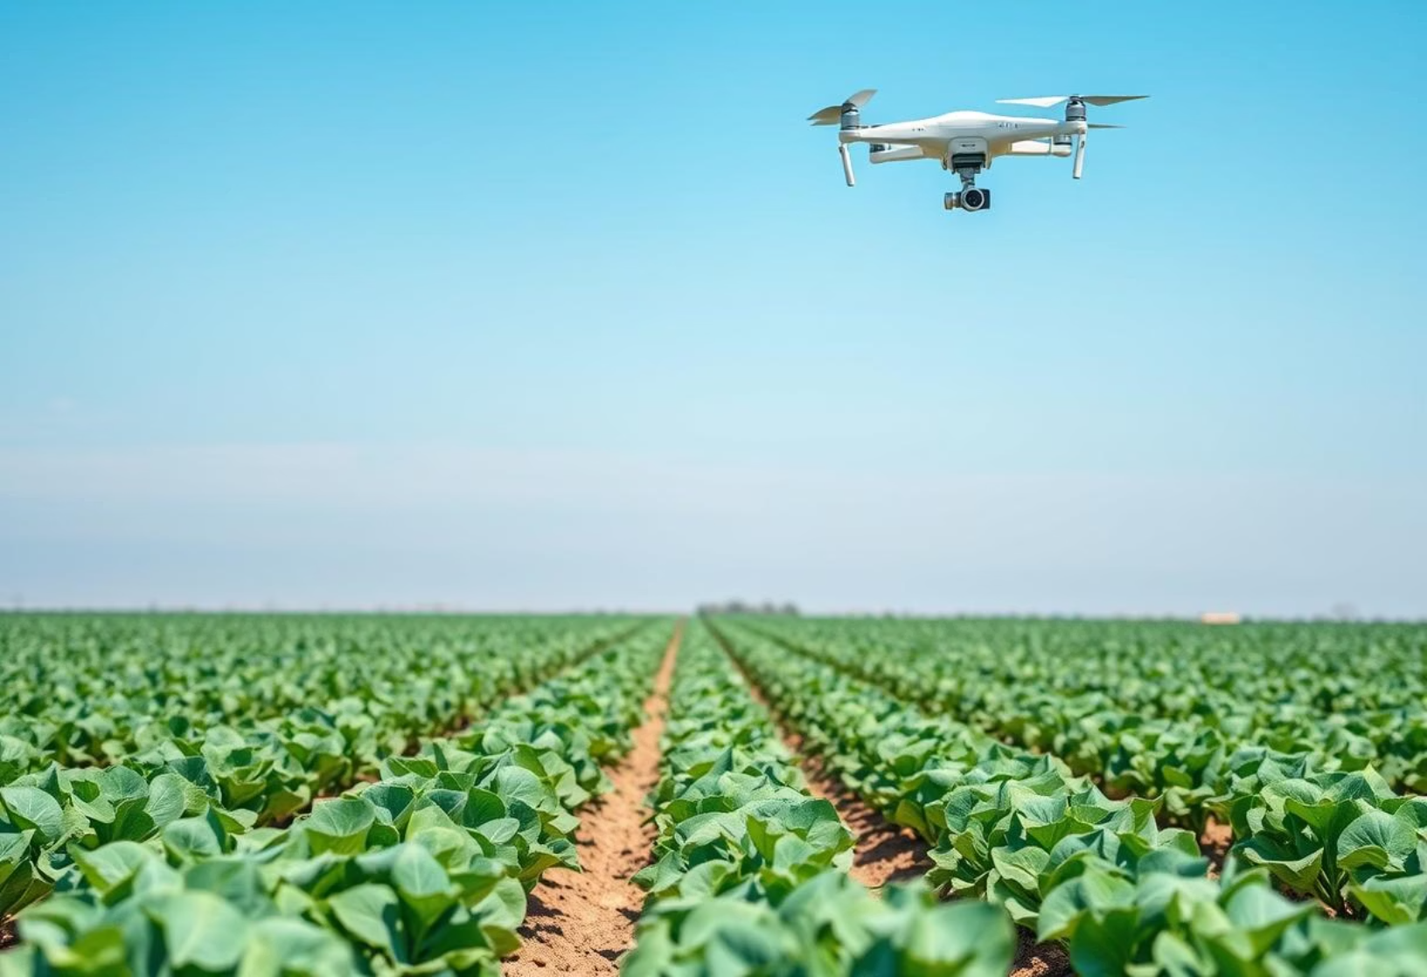
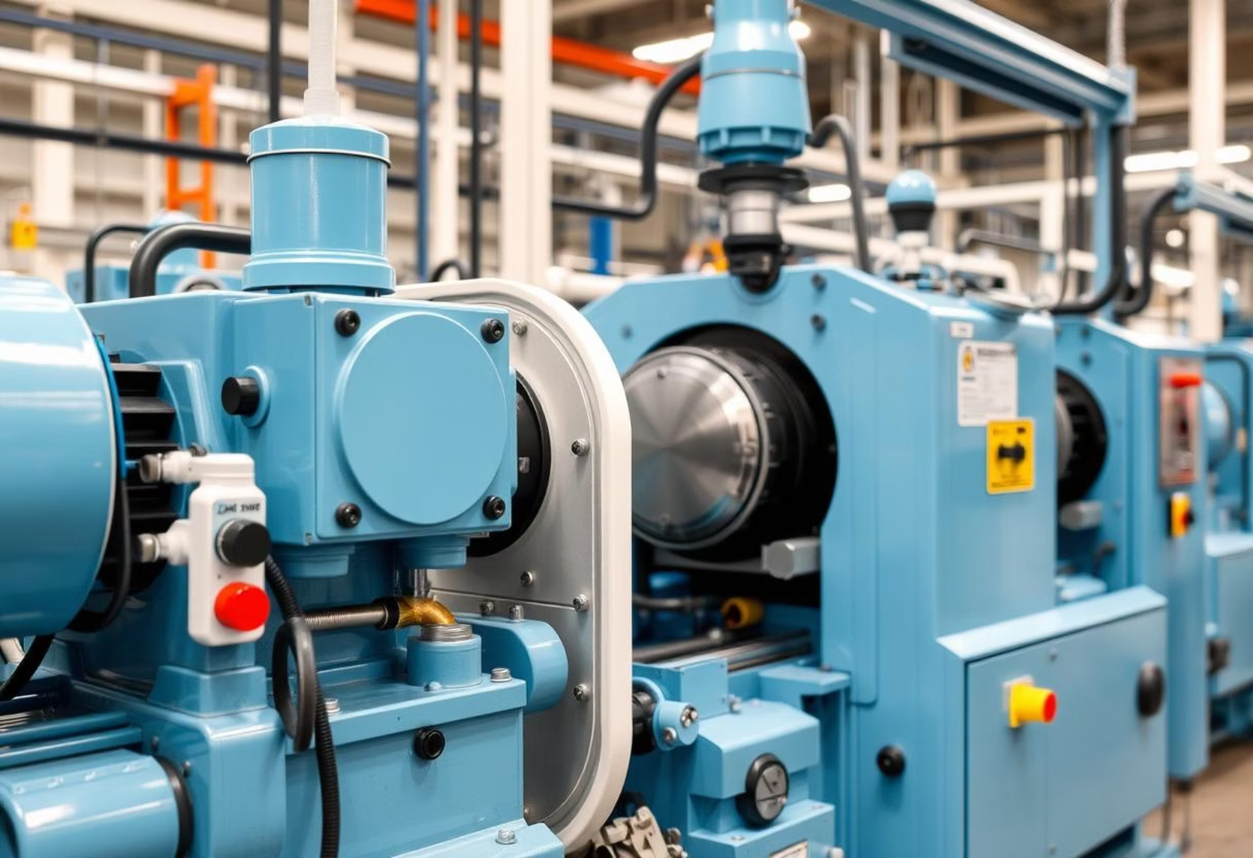
Case Studies: IIoT in Action
Smart Agriculture
Predictive Maintenance
IIoT sensors monitor soil moisture, nutrient levels, and weather patterns, enabling precision irrigation and fertilization. Automated systems manage livestock, track health, and optimize feeding, leading to increased yields and reduced resource consumption.
Sensors on industrial machinery continuously collect data on vibration, temperature, and performance. AI algorithms analyze this data to predict equipment failures before they occur, allowing for proactive maintenance and significantly reducing costly downtime.

Slide 12
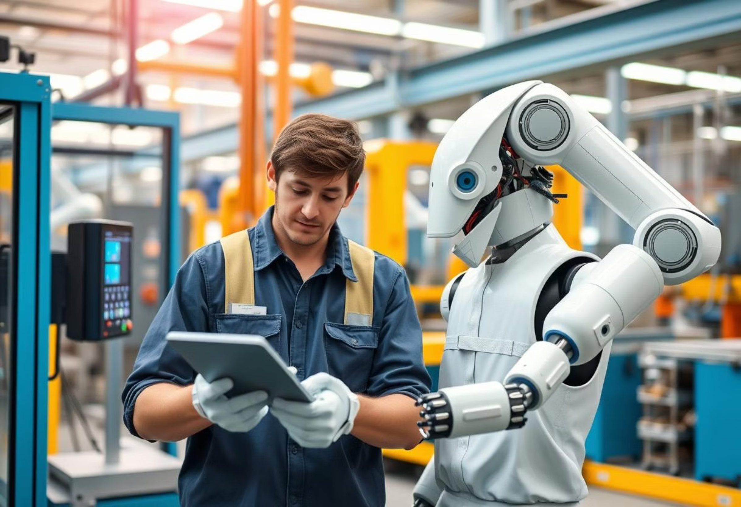
Sustainability & Human-Machine Collaboration
IIoT plays a crucial role in achieving sustainable industrial practices by monitoring energy consumption, waste generation, and emissions. This data allows companies to optimize processes for environmental protection.
Furthermore, Industry 5.0 emphasizes human-machine collaboration, leveraging IIoT to enhance worker safety, provide real-time assistance, and create more fulfilling jobs by automating repetitive tasks and augmenting human capabilities with intelligent systems.

Slide 13
Challenges and Future Trends
Challenges
Future Trends
Data Security & Privacy: Protecting sensitive industrial data from cyber threats.
Hyper-Automation: AI-driven automation expanding beyond traditional tasks.
Interoperability: Ensuring seamless communication between diverse systems and devices.
Digital Twins: Creation of virtual replicas for real-time monitoring and simulation.
Integration Complexity: Combining legacy systems with new IIoT technologies.
Sustainable IIoT: Increased focus on energy efficiency and waste reduction.
Skilled Workforce: Bridging the gap in expertise required for IIoT implementation and maintenance.
Edge AI Integration: More intelligent decision-making at the network edge.
Cost of Implementation: High initial investment for hardware, software, and infrastructure.
Human-Centric AI: Enhancing human capabilities with AI, not replacing them.

Slide 14




Faculty Use-Cases in Labs & Research
Remote Experimentation & Monitoring
Automated Data Collection & Analysis
Faculty can remotely monitor experiments, lab conditions, and equipment performance, ensuring continuous operation and data integrity from anywhere, reducing the need for constant physical presence.
IIoT sensors automatically collect vast amounts of research data from instruments, streamlining the data acquisition process and enabling advanced analytics for faster insights and discovery.
Enhanced Safety & Compliance
Resource Optimization & Efficiency
Real-time monitoring of environmental parameters like air quality, chemical levels, and equipment status helps maintain a safe laboratory environment and ensures adherence to regulatory compliance standards.
IIoT enables precise tracking of energy consumption, material usage, and equipment utilization, leading to optimized resource allocation and reduced operational costs in research facilities.

Slide 15
Next Steps & Call to Action
We've explored the transformative potential of Industry 5.0 and Industrial IoT. Now, let's discuss how we can collectively move forward.
We encourage you to consider how these concepts can be applied within your own areas of interest, research, or operations. Let's foster innovation and collaboration to build a smarter, more sustainable industrial future.Thank You! For collaborative discussions, write us to maddy@makeskilled.com

